Slide 1



U.S. Accidents
(2016-2023)
Zainab Alsaffar - DAB 16

Slide 2






Table of Content
Introduction
Analysis
Problem Statement
Recommendation

Slide 3
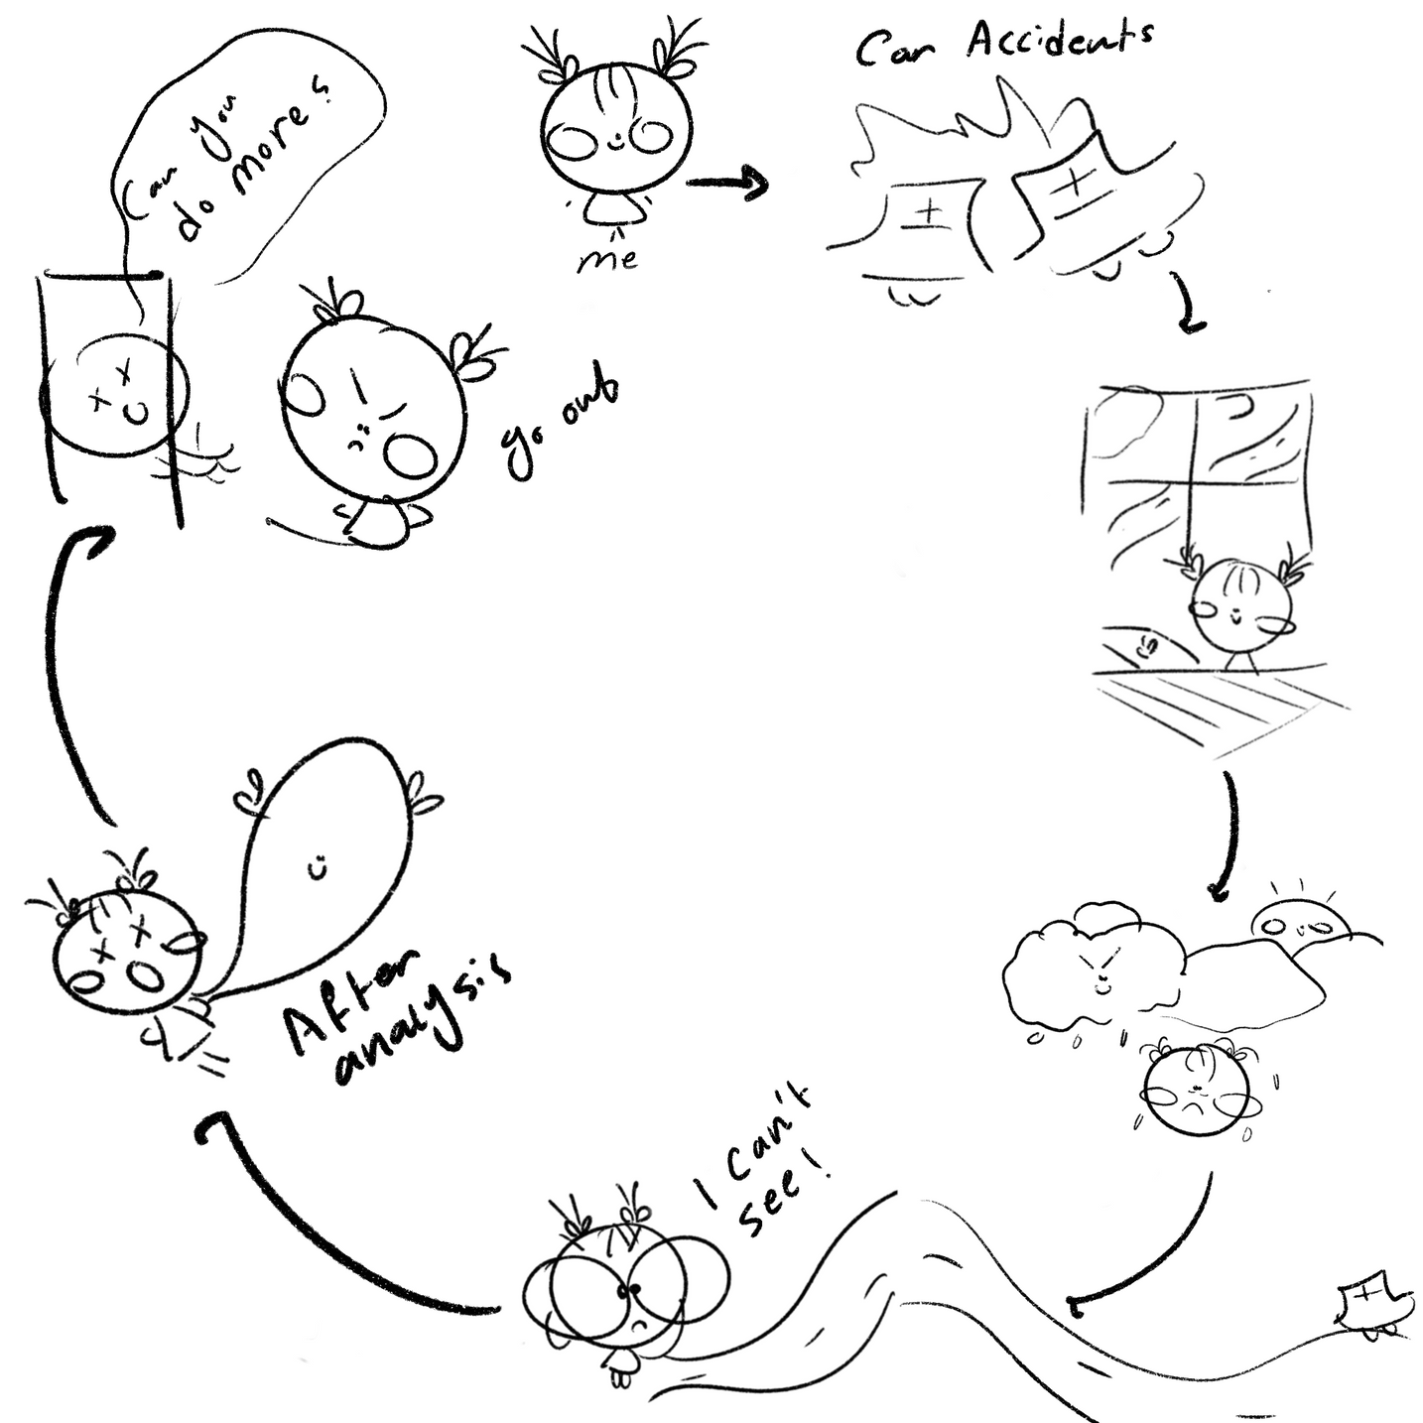
Introduction

Slide 4

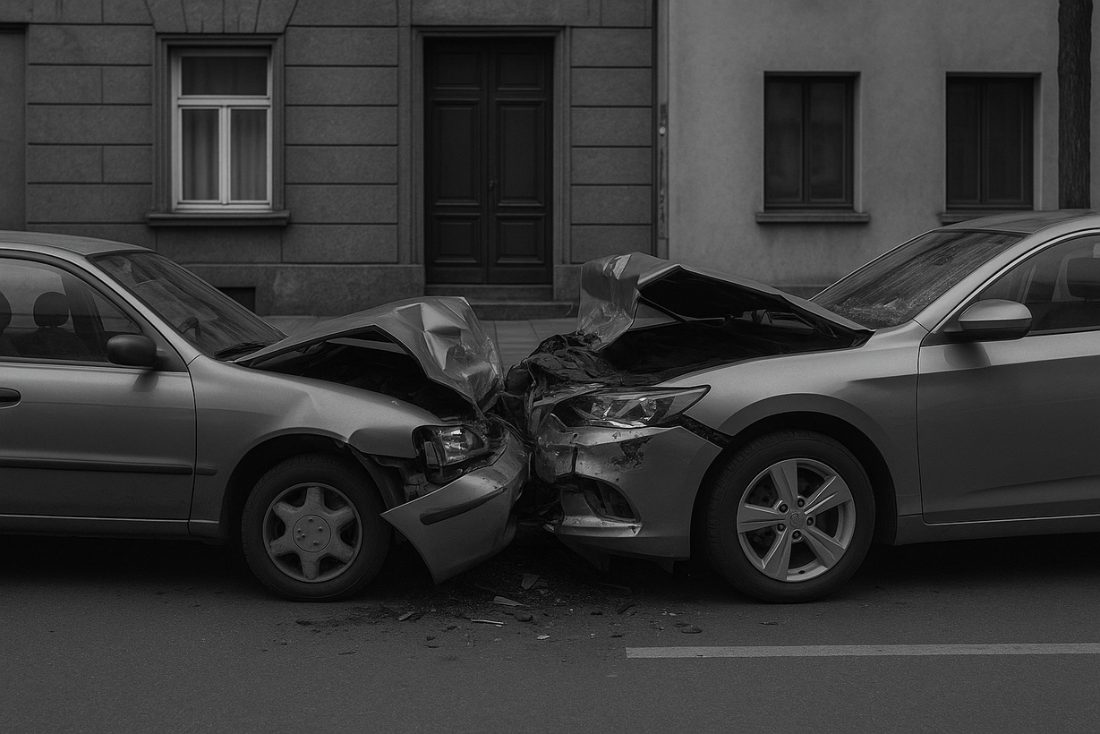

Problem Statement
The U.S. has reported over 7.7M traffic accidents between 2016 and 2023, leading to an increase in moderate to severe crashes across several states and a rise in injury rates and road safety risks.

Slide 5






Time Trend
&
State

Slide 6
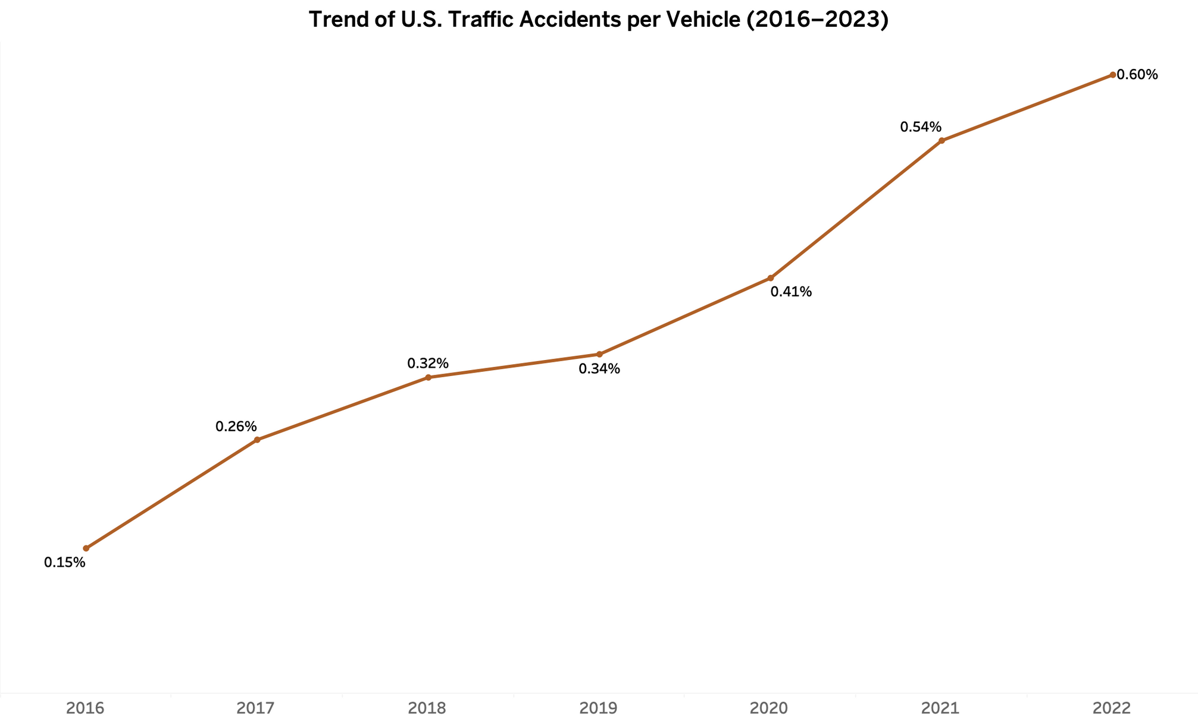


Slide 7
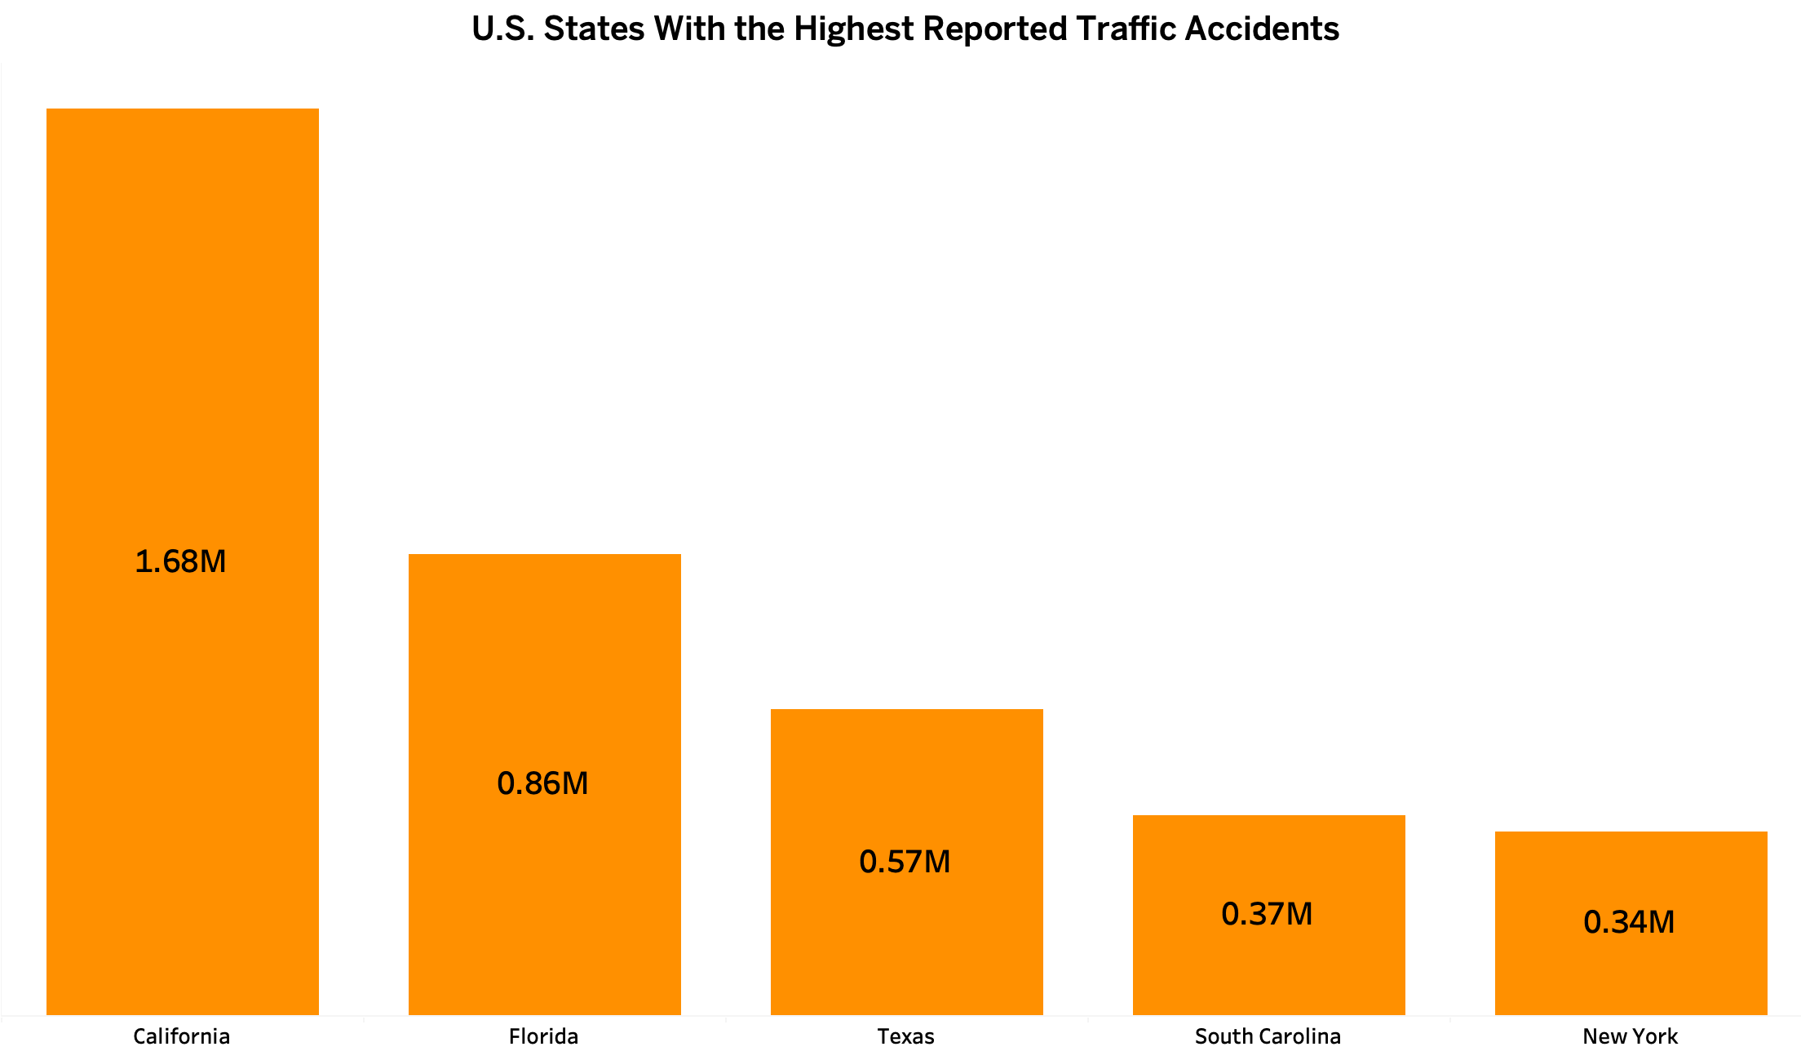

Slide 8



Severity

Slide 9
Severity Type
Moderate
6M
Number of Accidents
Severe
1M
Number of Accidents

Slide 10
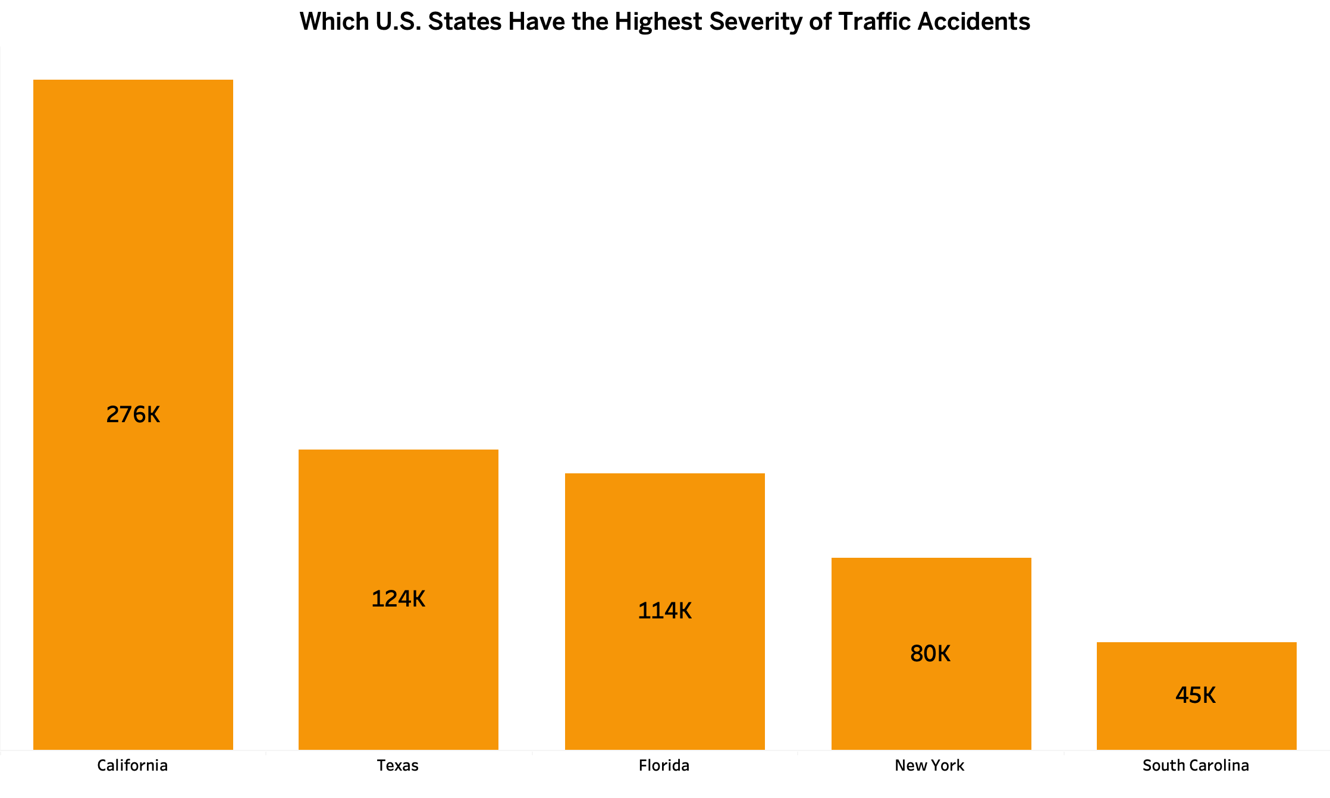

Slide 11



Day vs Night
Number of Accidents
Day: 5M
Night: 2M
Average Severity
Day: 2.20
Night: 2.21
Average Visibility
Day: 9.1
Night: 8.8

Slide 12
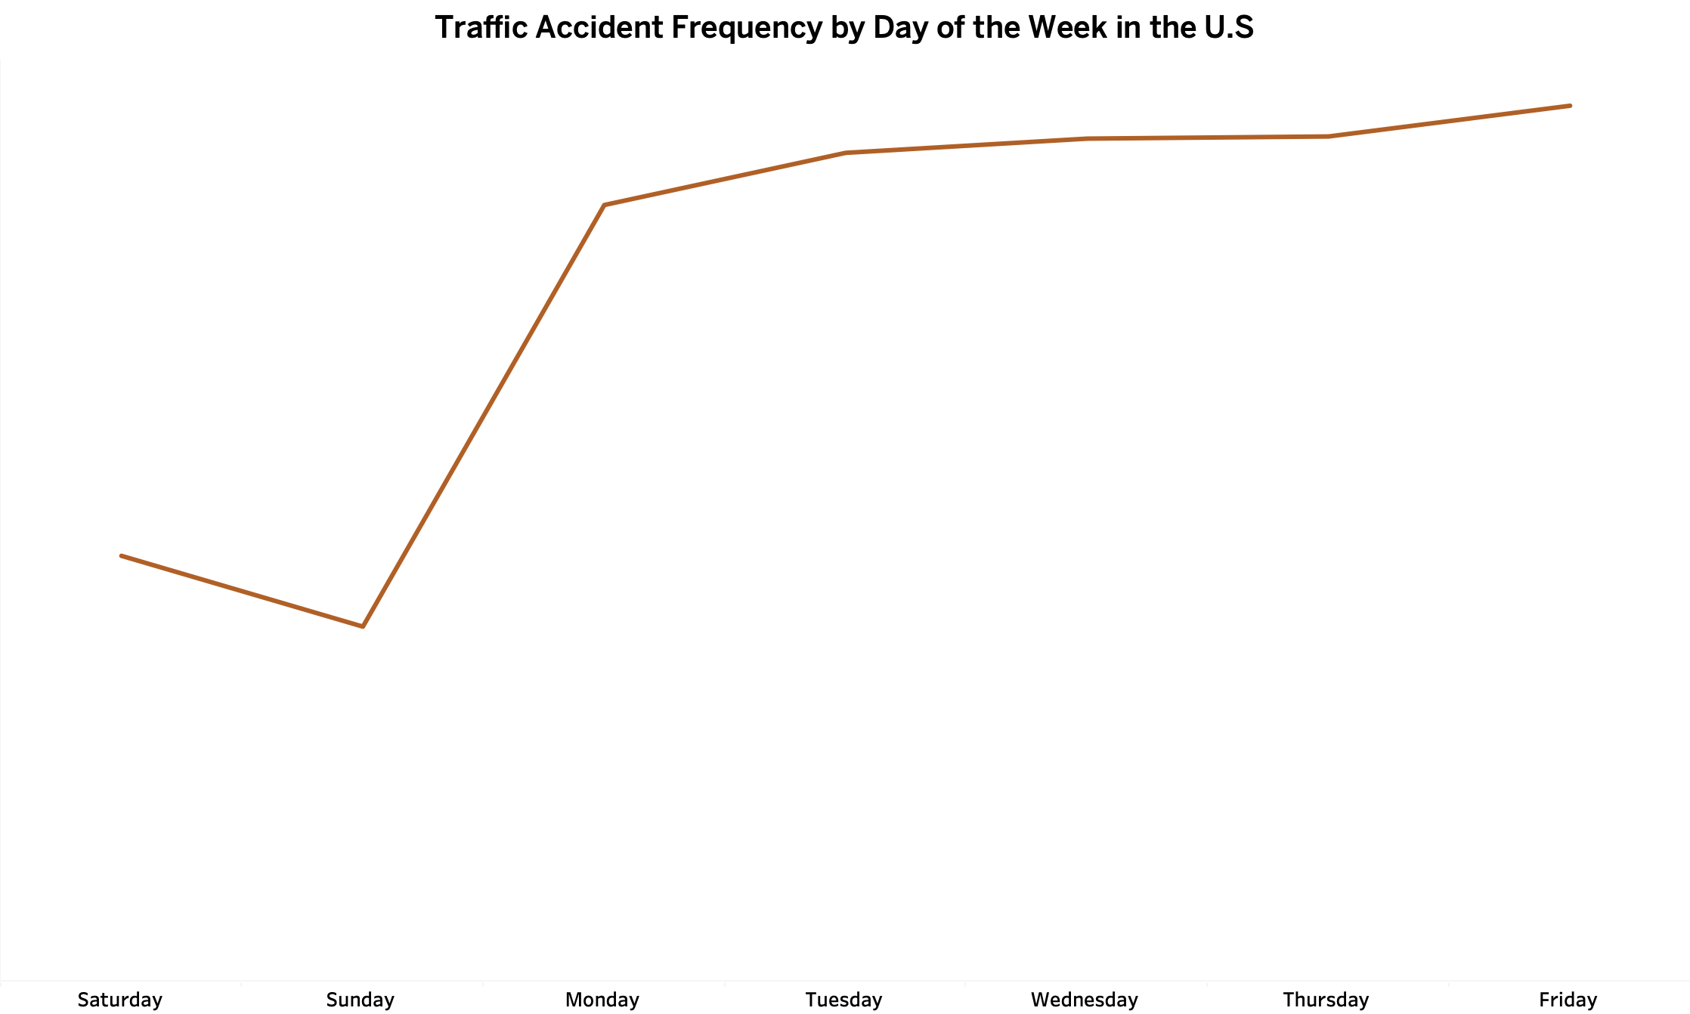

Slide 13
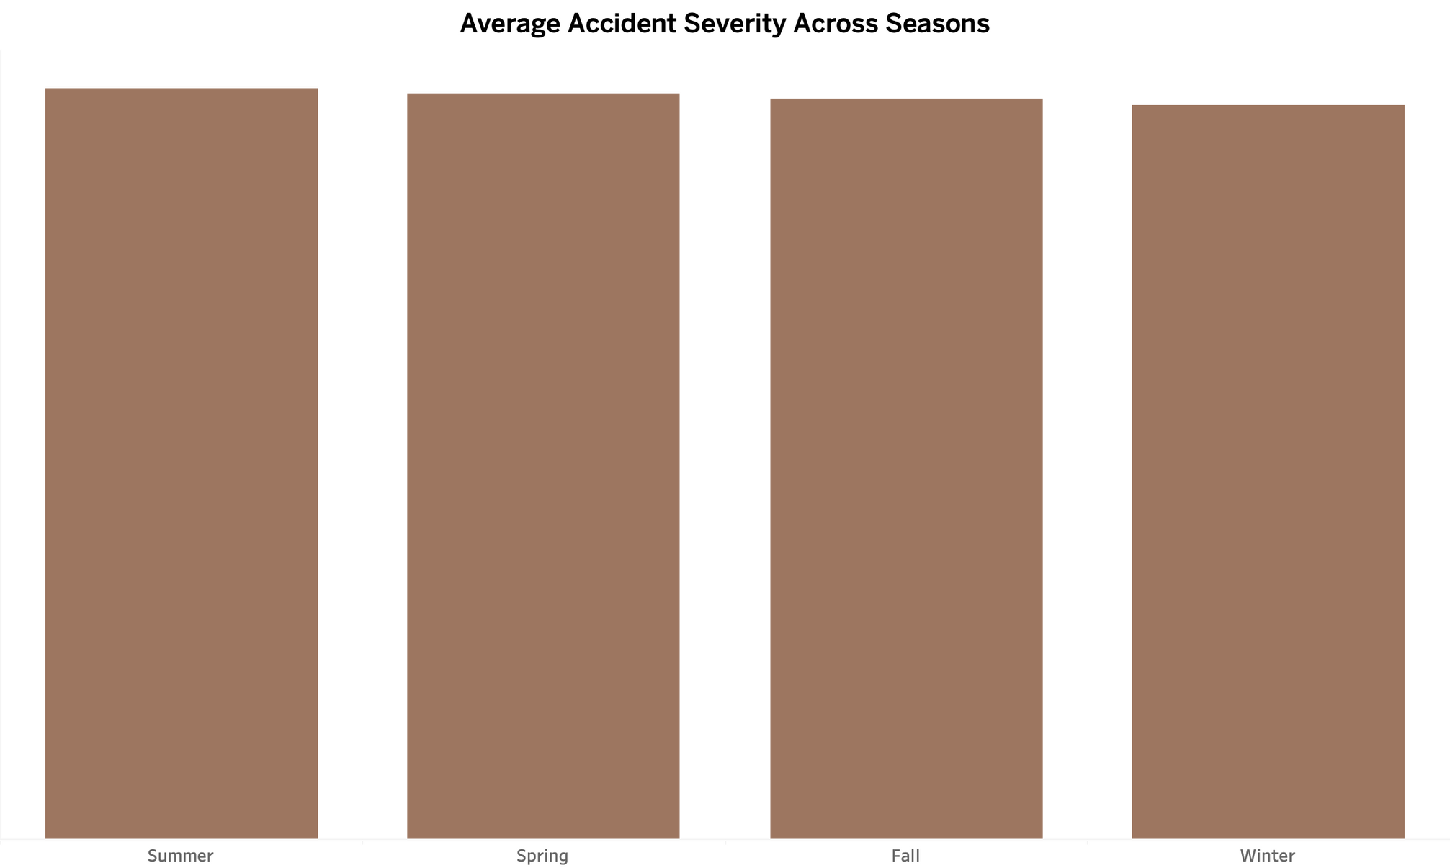





Slide 14
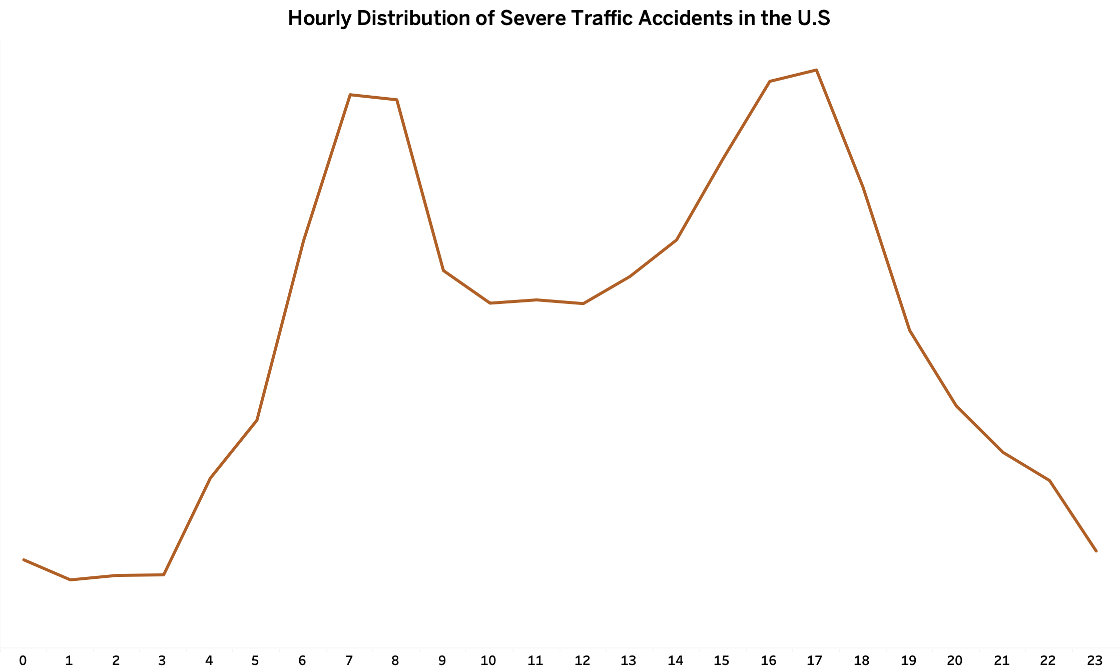

Slide 15



Weather
Condition

Slide 16
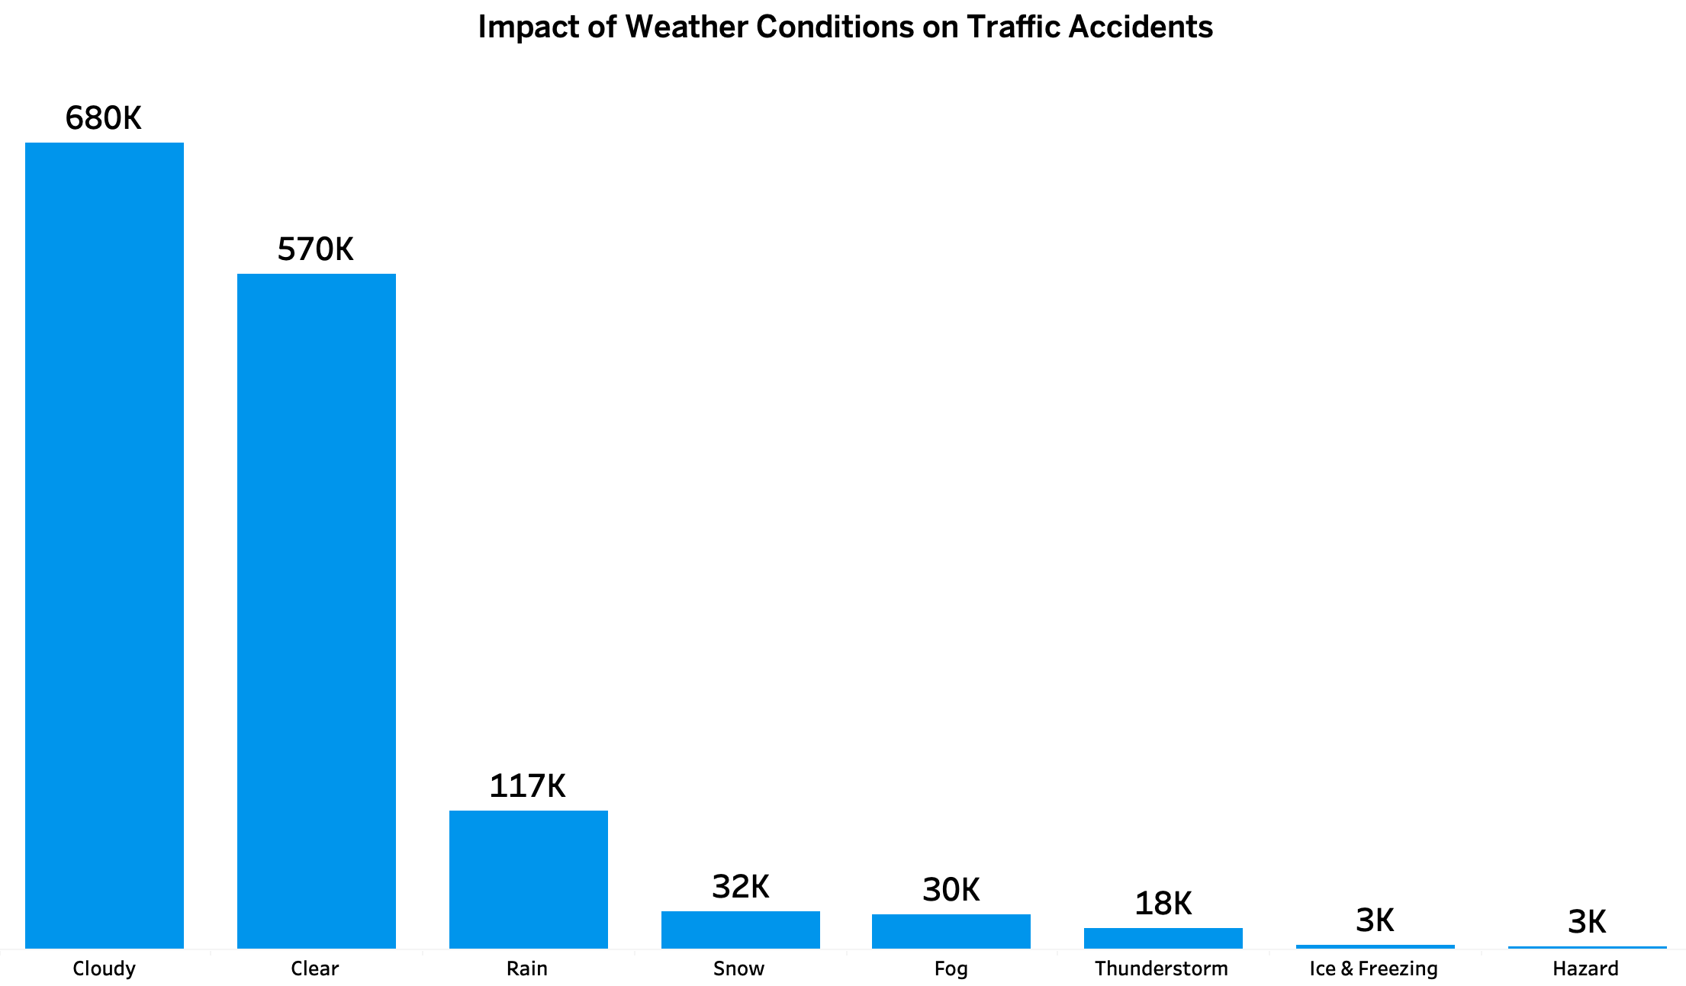

Slide 17



Visibility
It is the driver’s ability to clearly see the road and objects ahead while driving

Slide 18
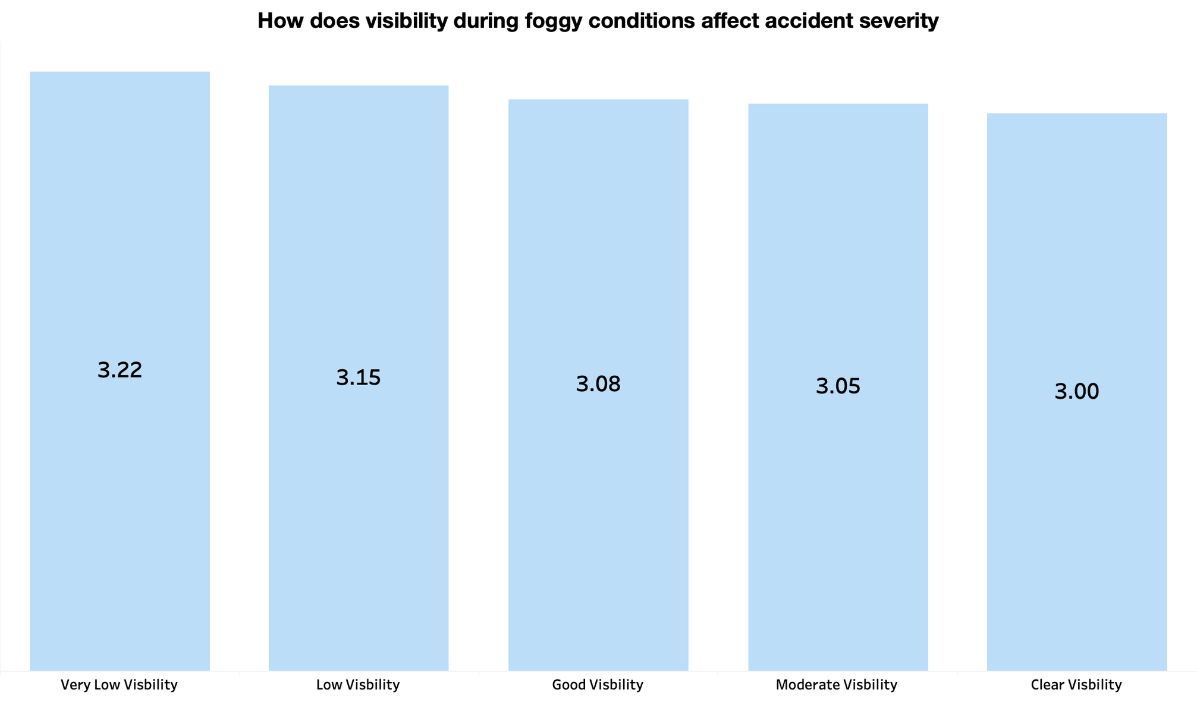

Slide 19
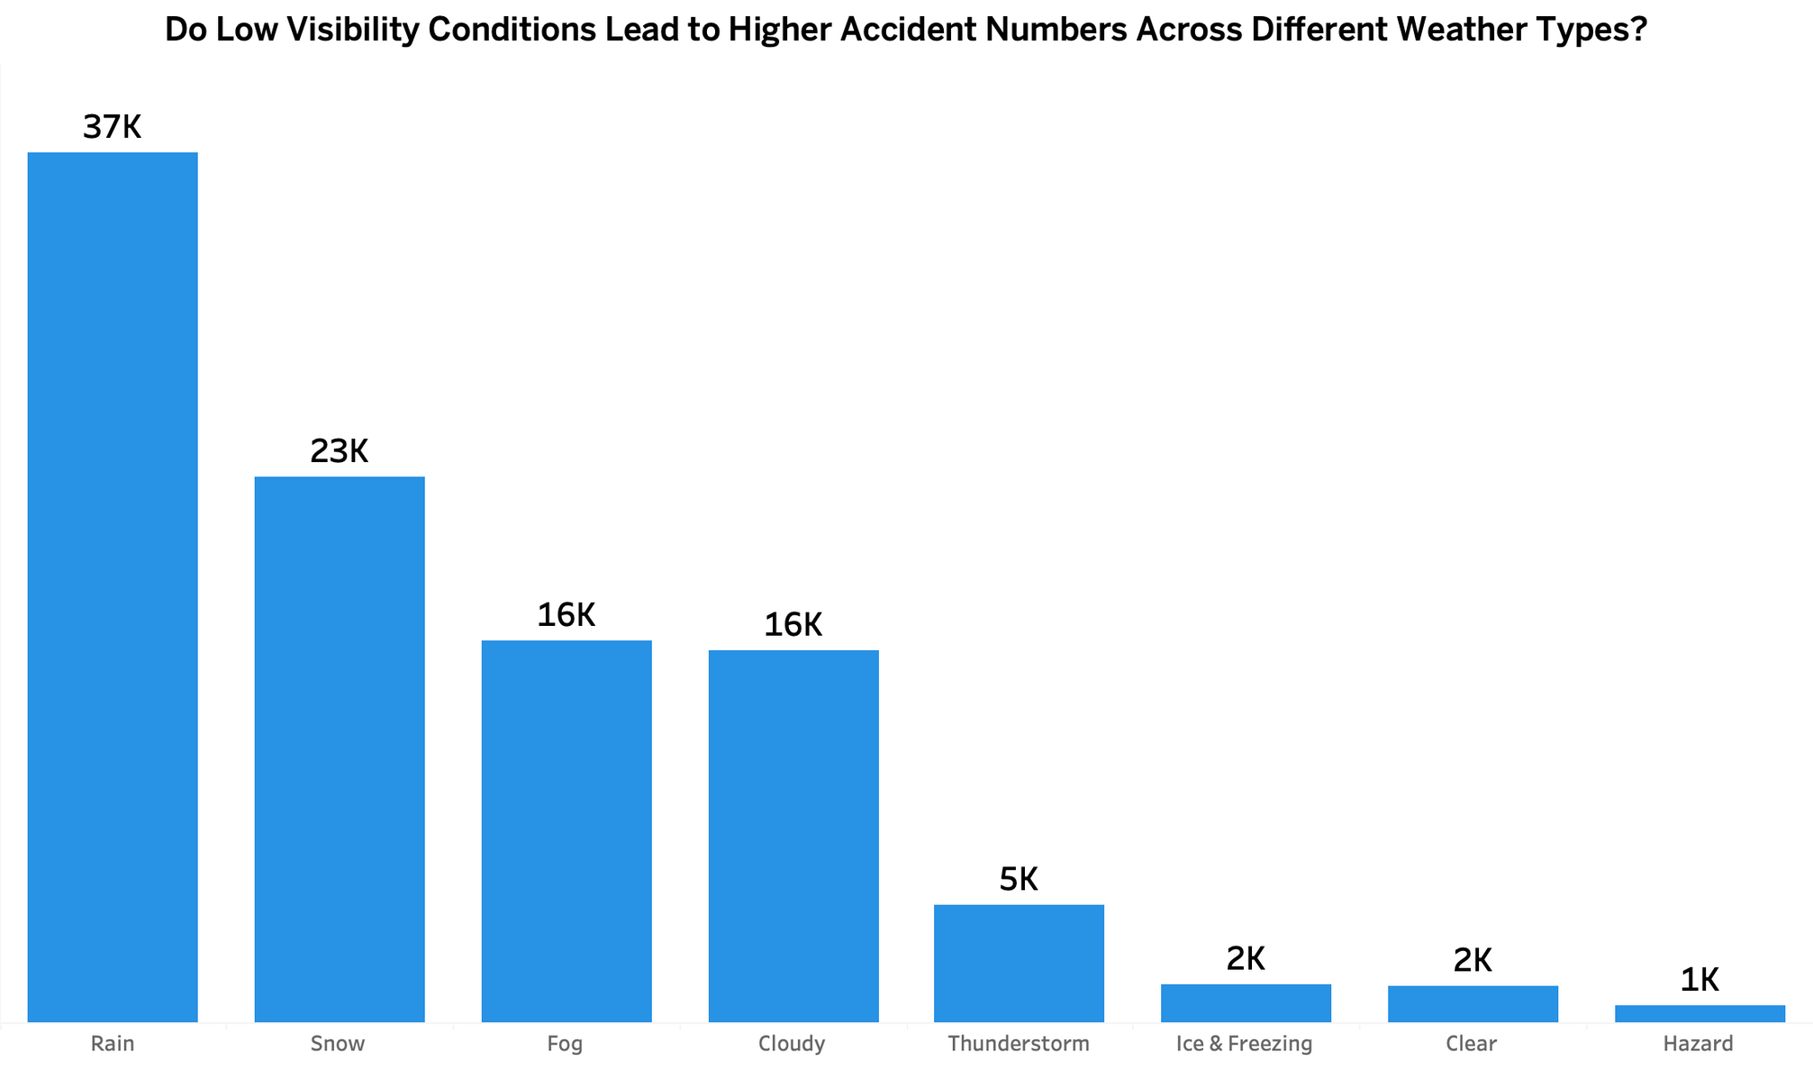

Slide 20
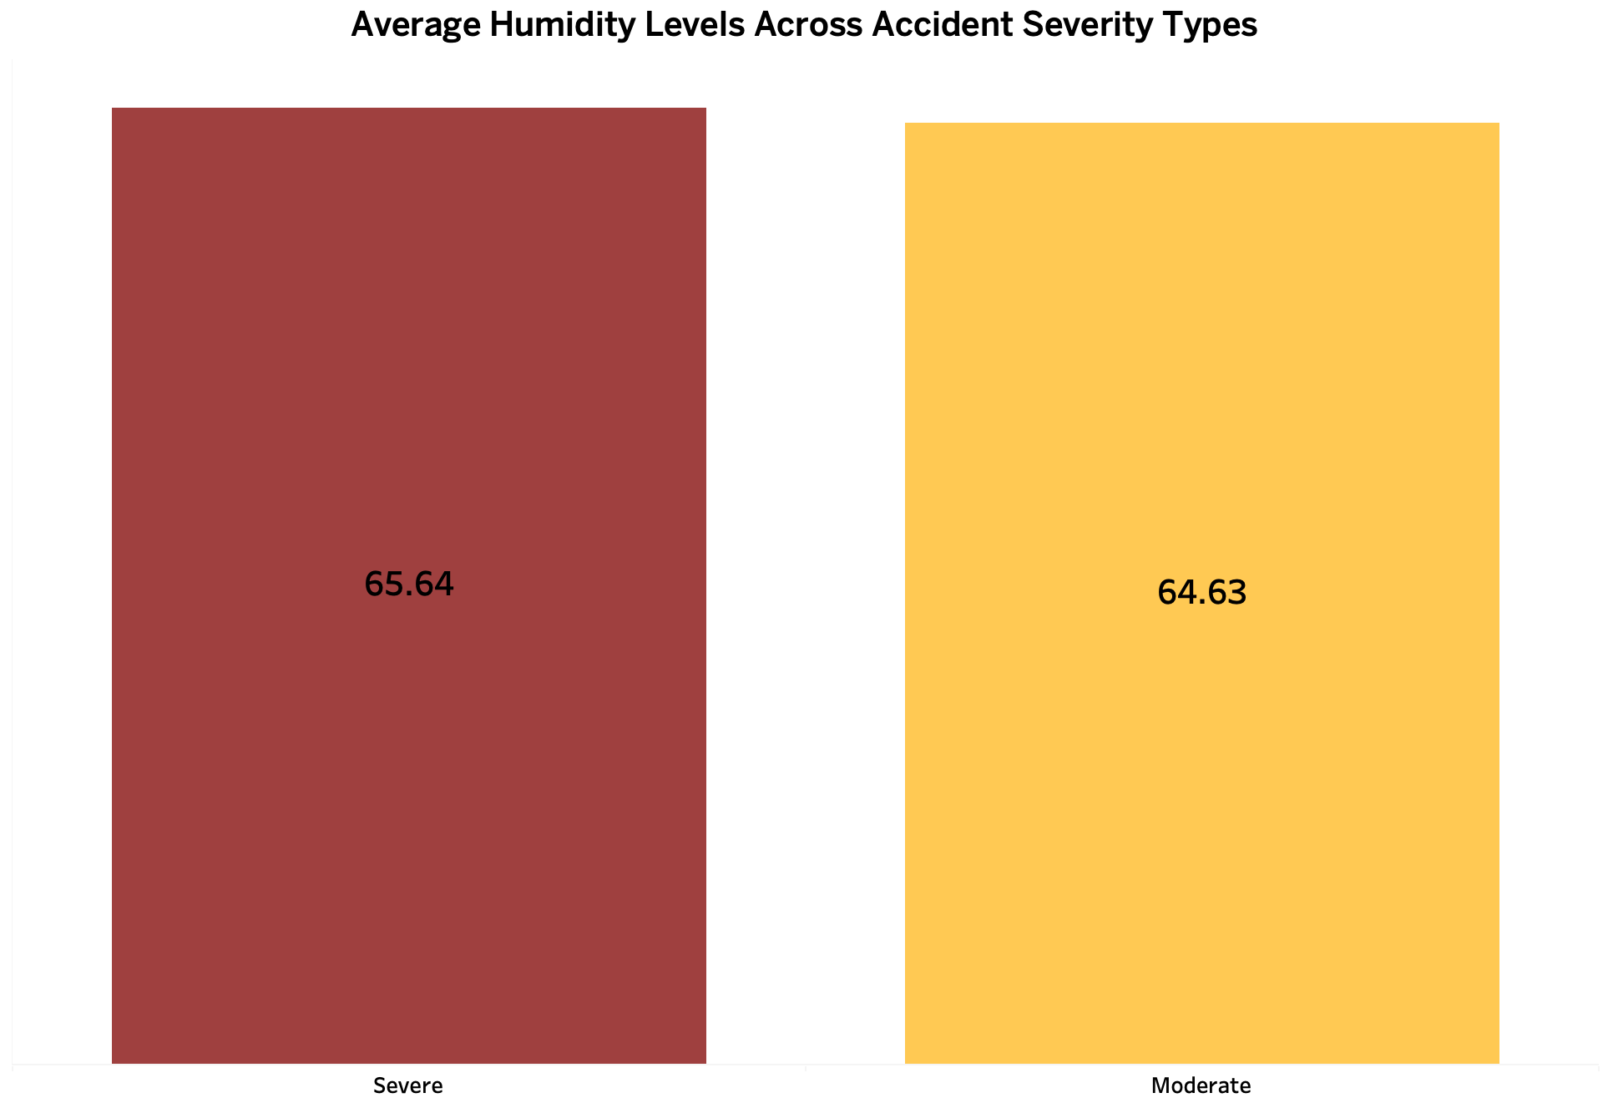

Slide 21



RoadType
&
Distance

Slide 22
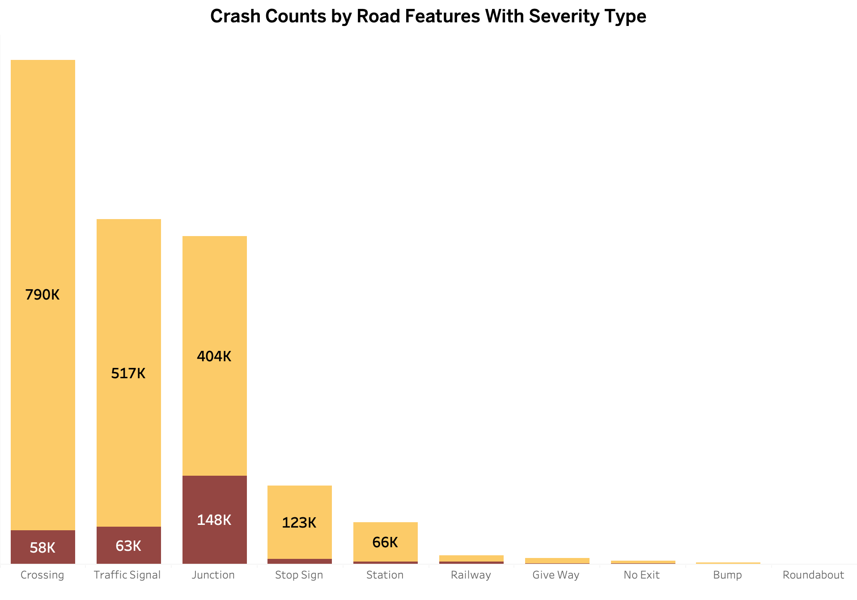
Moderate
Severe

Slide 23
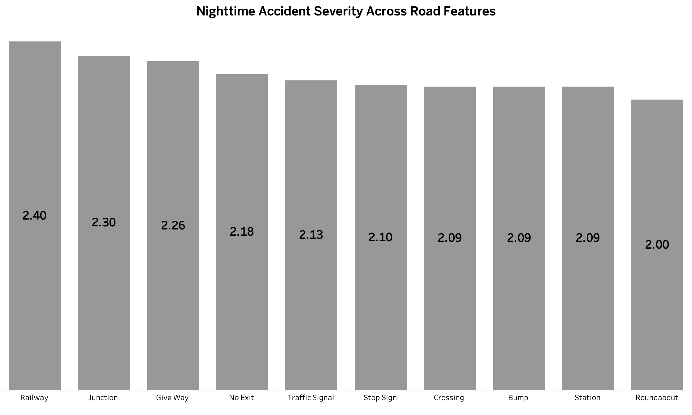

Slide 24



Distance
Refers to the amount of space a vehicle travels from one point to another
measured in miles (mi)

Slide 25
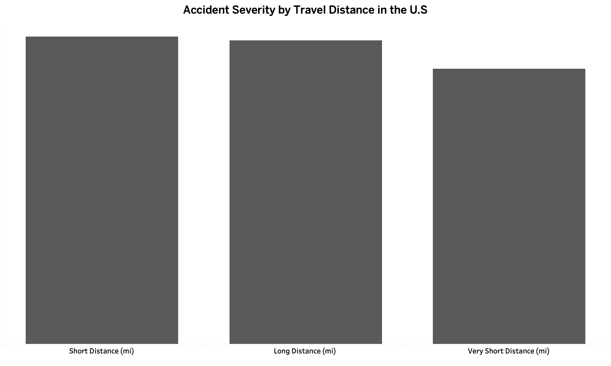

Slide 26











Recommendations
Improve Road Infrastructure
Weather Hazard Alerts
Road Safety Awareness
Better Nighttime Lighting
Rush-Hour Traffic Control
Encourage Safe Driving

Slide 27




Thank
You for
Listening

